Slide 1

Networking with
Java Socket Programming

Slide 2
Content
What is the socket programming ?
History and who invented ?
What kind of problems does it solve?
What prerequisities ?
Socket and ServerSocket class.
Which platforms can it run ?
How can we install ?
Conclusion.
Example.

Slide 3
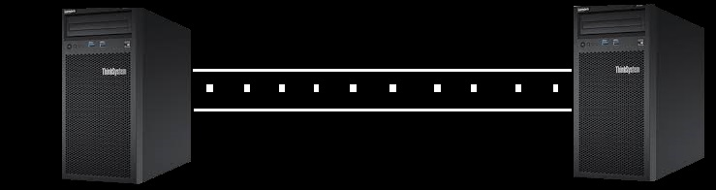
What is socket programming ?
Socket programming, use to make connection between processes or machines which communicating each other.
We can think as a channel on the network where data packets incoming and outgoing.
Server port Client port

Slide 4
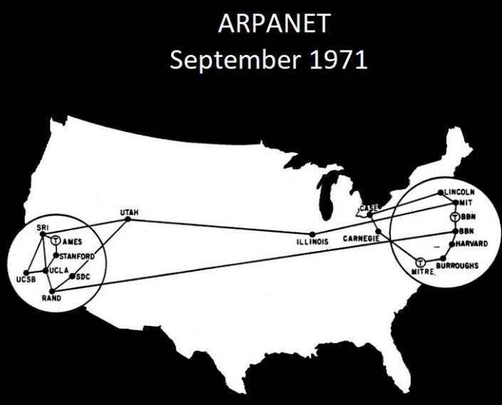
History and Who Invented ?
Joel M. Winett in 1971 at Massachusetts Institute of Technology
ARPANET
Berkeley sockets released in 1983
Originated Unix Operating System.
POSIX Sockets
TCP
UDP
UNIX
RAW
RFC 147 https://tools.ietf.org/html/rfc147

Slide 5
What kind of problems does it solve ?
It makes easier network connectivity of devices.
Real time applications, receiving and sending data, internet protocols.
Communication between processes, users, machines.
Communication protocols like HTTP, FTP, SMTP built on the socket structure.
File Transmission.
.

Slide 6
What prerequisites ?
Any programming knowledge, Python, Java, C and etc.
We will use Java.
Basic network knowledge is enough.

Slide 7
Socket Class
Socket class use to create socket
Some important methods
public InputStream getInputStream() → returns the InputStream attached with this socket.
public OutputStream getOutputStream() → returns the OutputStream attached with this socket.
public synchronized void close() → closes this socket.
Required libraries
java.net.*,
java.io.*
Creating Server
ServerSocket ss=new ServerSocket(4444);
Socket s=ss.accept();
Creating Client
Socket s=new Socket("localhost",4444); or Socket s=new Socket("127.0.0.1",4444);

Slide 8
ServerSocket class
ServerSocket class use to create server socket.
Some important methods
public Socket accept() → returns the socket and establish a connection between server and client.
public synchronized void close() → closes this socket.

Slide 9





On which platforms can it run ?

Slide 10
How can we install?
Netbeans
https://www.oracle.com/technetwork/java/javase/downloads/jdk-netbeans-jsp-3413139-esa.html
Eclipse
https://www.eclipse.org/downloads/download.php?file=/oomph/epp/2020- 03/R/eclipse-inst-win64.exe
IntelliJ
https://www.jetbrains.com/idea/download/#section=windows

Slide 11
Conclusion
As you see networked devices need to socket structure to realize connectivity.
Socket structure takes host and port number so we don’t need to identify one by one.
It makes easier to implement general communications.
But sometime building connection is impossible caused by security restrictions so hosts may reject request.
Reference
https://www.javatpoint.com/socket-programming

Slide 12

EXAMPLE

